Slide 1

Bike Sharing Prediction Model
GROUP CODE -276
PROJECT PARTNERS:
YASH AGRAWAL
SHUBHAM MADKE
DIKSHA AGRAWAL

Slide 2
ABOUT THE PROJECT
Some of the investors try to come with an investment in the bike-sharing for their business point of view.
They could not understand how they can invest money in that business process.
So, for their cash flow and business profit, we need to build a model that can predict and forecast the count of rides through processing on factors including season, weather conditions and temperature.

Slide 3
DATASET
HOURS.CSV
DAYSCSV
The dataset contains the corresponding weather and seasonal information about the rental bikes between 2011 and 2012 in the capital bike share system.
The dataset contains the hourly and daily counts of rental bikes.
This dataset consists of two CSV files
DATASET WAS FOUND ON UCI:
https://archive.ics.uci.edu/ml/datasets/Bike+Sharing+Dataset

Slide 4
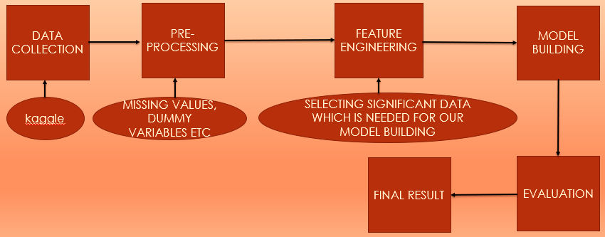
SYSTEM FLOW OF OUR PROJECT

Slide 5
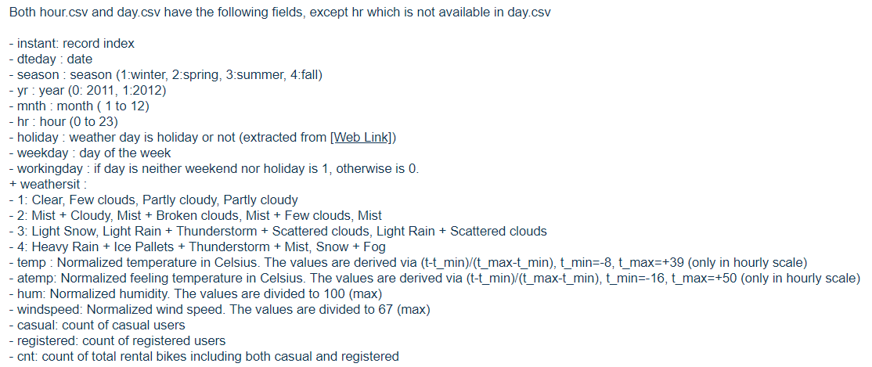
DATA UNDERSTANDING
We will use this information to analyze the behavior of the bike mobility in different seasons.
The mobility(count of rides) can be analyzed by the features such as:

Slide 6
MODELLING AND ANALYSIS THAT WE ARE GOING TO USE ON OUR DATA
N-FOLD BACKWARD SELECTION
STEP-AIC
BEST MODEL WITH GOOD ADJUSTED –R2
STOCHASTIC GRADIENT BOOSTING
KNN
RANDOM FOREST
BAGGED CART
SVM

Slide 7




DATA ANALYSIS
AFTER ANALYSIS WE FOUND
DEPENDENT VARIABLE
COUNT
INDEPENDENT VARIABLE
SEASON, WEATHER, YR, HOLIDAY, WEEKDAY, WORKING DAY, MONTH, HR, CASUAL/REGISTERED, TEMPERATURE, ATEMP, HUM, WINDSPEED
After analyzing we will check the correlation of each independent attribute with our dependent attribute which is “count”.
Plot the graphs of each independent variable and then we will understand whether there is a positive or negative correlation between the independent variable and our dependent variable “count”.

Slide 8
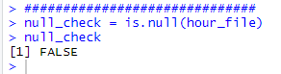
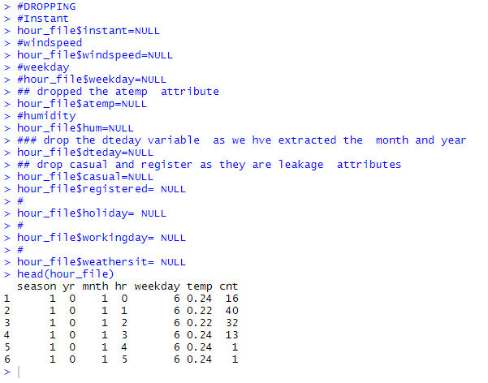
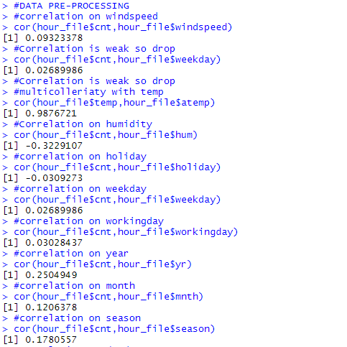
DATA PRE-PROCESSING (HOUR.CSV)
FINDING MISSING VALUES
CHECK CORRELATION
FINDING ANY MULTI-COLINEARITY

Slide 9
(HOUR.CSV) (REMOVING UNWANTED VARIABLES DURING DATA PRE-PROCESSING)
INSTANT – Only Index Not needed.
ATEMP – Since it has a multicollinearity problems with “temp”.
REGISTERED / CASUAL – Since it has data leakage which contributes towards “count” variable.
WINDSPEED – Since the correlation is low with respect to “count”.
WORKINGDAY – This variable has very low impact on “count” variable.
DTEDAY – from the dteday we can infer that we need month and year to analyze the count for two years
So its better to drop the dteday and include the year and month in the model
HUM – IT HAS A LOW CORRELATION VALUE WITH RESPECT TO COUNT
HOLIDAY – IT HAS A LOW CORRELATION VALUE HENCE ITS IMPACT WOULD BE LOW WITH RESPECT TO COUNT

Slide 10
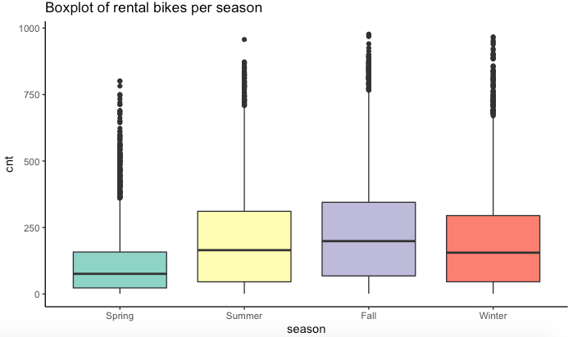
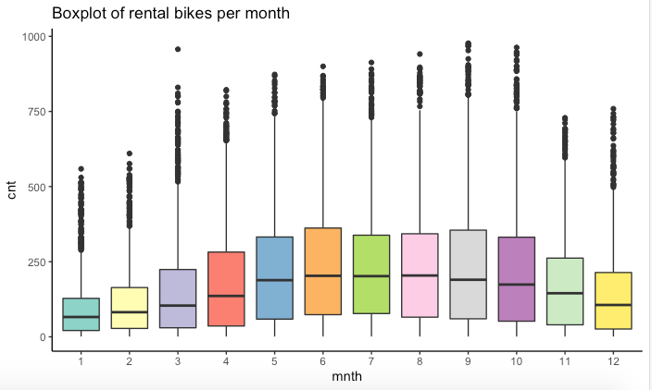
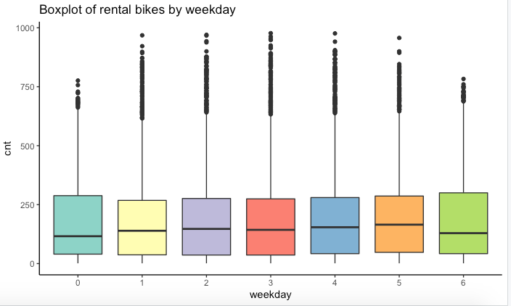
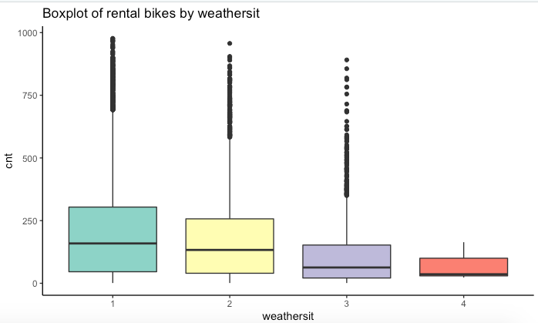
ANOVA
What variables are we using to build anova model? Why are we building anova?

Slide 11
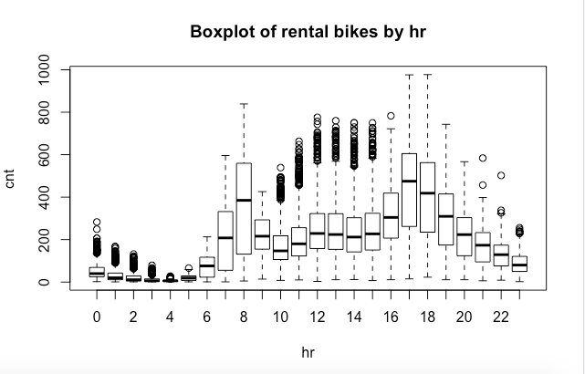
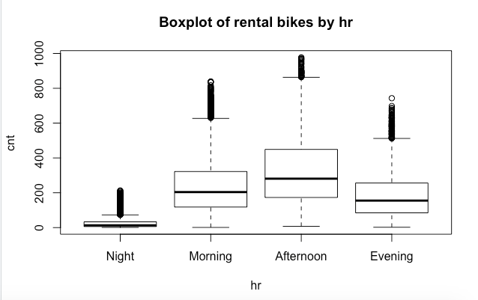
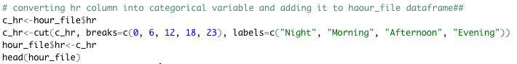
ANOVA

Slide 12
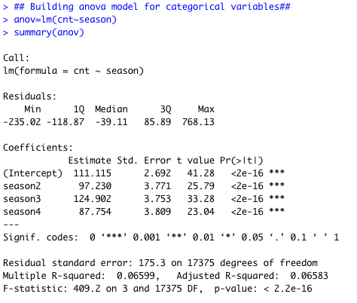
ANOVA
Confidence level : 95%
Alpha: 0.05
Null hypothesis: Group mean is same for all the seasons
Alternate hypothesis: Group mean is not same for all seasons
Analysis: Base is season1. P-value is than alpha. Hence, reject null hypothesis
Greatest value of season is 124.902 which is season3

Slide 13
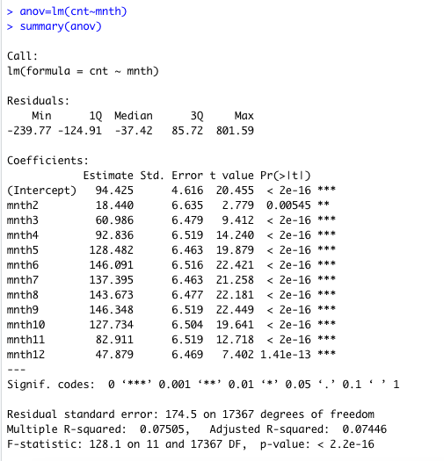
ANOVA
Confidence level : 95%
Alpha: 0.05
Null hypothesis: Group mean is same for all the months
Alternate hypothesis: Group mean is not same for all months
Analysis: Base is mnth1. P-value is than alpha. Hence, reject null hypothesis
Greatest value of month is 146.348 which is mnth9

Slide 14
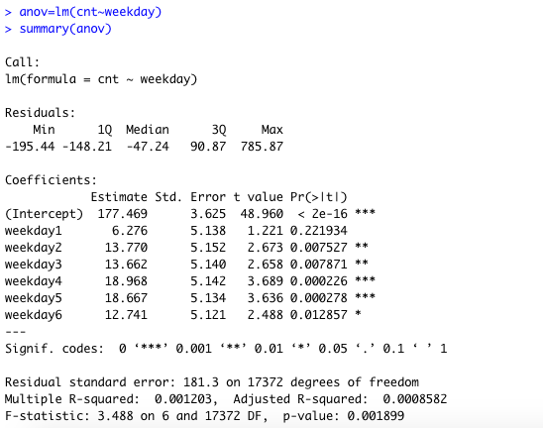
ANOVA
Confidence level : 95%
Alpha: 0.05
Null hypothesis: Group mean is same for all the weekday
Alternate hypothesis: Group mean is not same for all weekday
Analysis: Base is weekday0. P-value is than alpha. Hence, reject null hypothesis
Greatest value of weekday is 18.968 which is weekday4

Slide 15
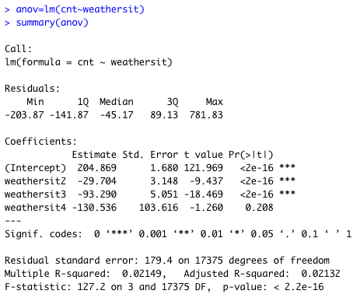
ANOVA
Confidence level : 95%
Alpha: 0.05
Null hypothesis: Group mean is same for all the weather situation
Alternate hypothesis: Group mean is not same for all weather situation
Analysis: Base is weathersit1. P-value is than alpha. Hence, reject null hypothesis
Greatest value of weathersit is -29.704 which is weathersit2

Slide 16
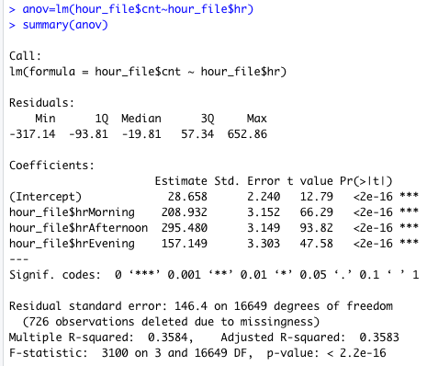
ANOVA
Confidence level : 95%
Alpha: 0.05
Null hypothesis: Group mean is same for all the hours
Alternate hypothesis: Group mean is not same for all hours
Analysis: Base is Night. P-value is than alpha. Hence, reject null hypothesis
Greatest value of hour is -295.480 which is Afternoon

Slide 17
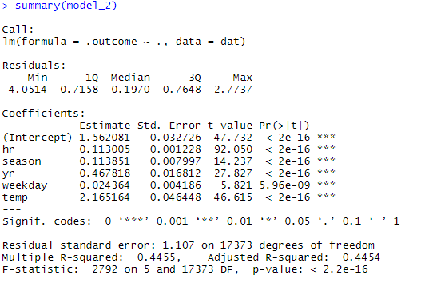
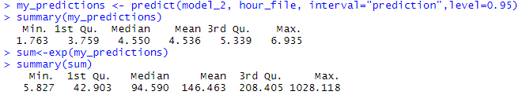
MODEL BUILDING (HOUR.CSV) MULTIPLE LINEAR REGRESSION USING (N-FOLD)
WE WILL BE USING N-FOLD CROSS VALIDATION USING BACKWARD ELIMINATION.
USING 95 % CONFIDENCE LEVEL
From the N-fold cross validation we get
Following results :
Adj-R2 – 0.4454
THIS RESULTS ARE OBTAINED BY USING THE LOG OF COUNT ATTRIBUTE
AFTER APPLYING THE MODEL ON LOG(COUNT)
WE USED PREDICT FUNCTION AND CALCULATED THE EXPONENTIAL VALUES OF THE ORIGINAL CPUNT ATTRIBUTE

Slide 18
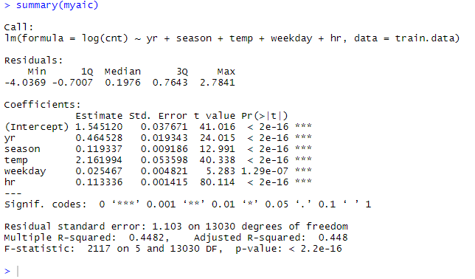
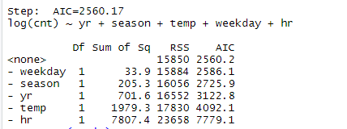
USING AIC / BIC METRICS (HOUR.CSV)
NOW WE BUILD A MODEL USING STEP-AIC (FORWARD/BACKWARD AND BOTH)
USING 95 % CONFIDENCE LEVEL
From the AIC /BIC METRICS we get
Following results :
Adj-R2 – 0.448
AIC Value : 2560.17
Which is
Less than
2560.22
And
REST ALL AIC VALUES

Slide 19




SINCE OUR HOUR.CSV IS NOT GIVING US A BEST MODEL FOR ANALYSIS WE THEN SHIFT TOWARDS DAY.CSV

Slide 20
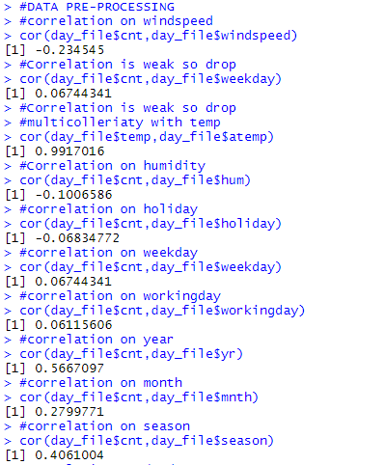
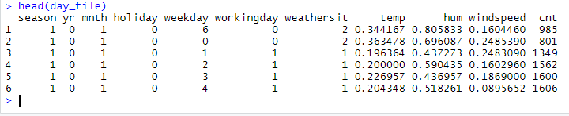
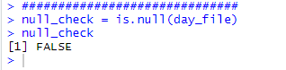
DATA PRE-PROCESSING (DAY.CSV)
FINDING MISSING VALUES
CHECK CORRELATION
FINDING ANY MULTI-COLINEARITY

Slide 21
(DAY.CSV) (REMOVING UNWANTED VARIABLES DURING FEATURE SELECTION) season+yr+mnth+holiday+weekday+workingday+weathersit+temp+hum+windspeed
INSTANT – Only Index Not needed.
ATEMP – Since it has a multicollinearity problems with “temp”.
REGISTERED / CASUAL – Since it has data leakage which contributes towards “count” variable.
DTEDAY – from the dteday we can infer that we need month and year to analyze the count for two years
So its better to drop the dteday and include the year and month in the model
HOLIDAY – IT HAS A LOW CORRELATION VALUE HENCE ITS IMPACT WOULD BE LOW WITH RESPECT TO COUNT

Slide 22
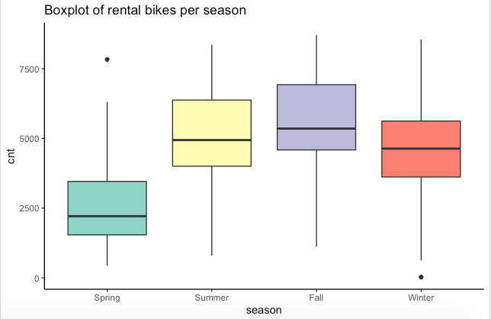
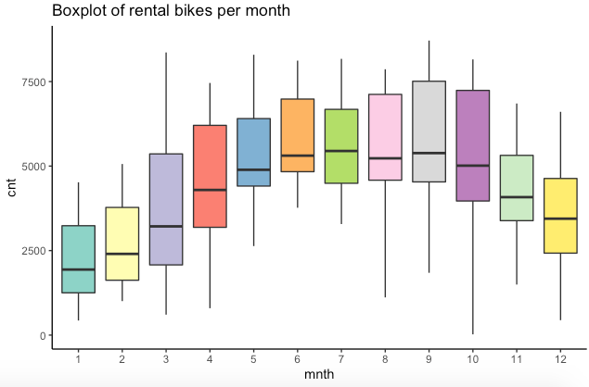
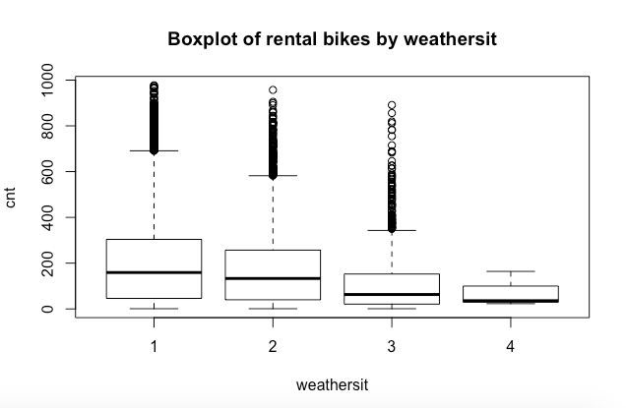
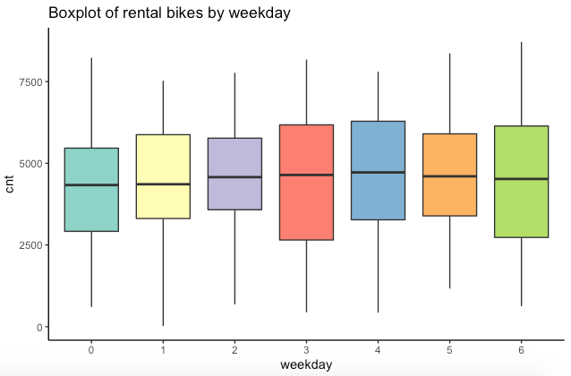
ANOVA
What variables are we using to build anova model? Why are we building anova?

Slide 23
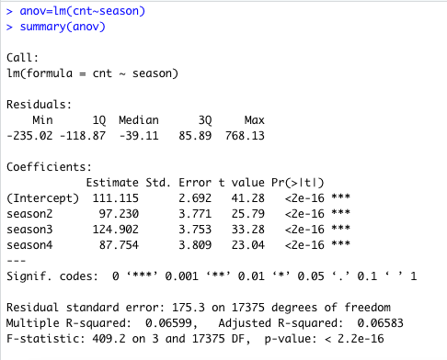
ANOVA
Confidence level : 95%
Alpha: 0.05
Null hypothesis: Group mean is same for all the seasons
Alternate hypothesis: Group mean is not same for all seasons
Analysis: Base is season1. P-value is than alpha. Hence, reject null hypothesis
Greatest value of season is 124.902 which is season3

Slide 24
ANOVA
Confidence level : 95%
Alpha: 0.05
Null hypothesis: Group mean is same for all the months
Alternate hypothesis: Group mean is not same for all months
Analysis: Base is mnth1. P-value is than alpha. Hence, reject null hypothesis
Greatest value of month is 146.348 which is mnth9

Slide 25
ANOVA
Confidence level : 95%
Alpha: 0.05
Null hypothesis: Group mean is same for all the weekday
Alternate hypothesis: Group mean is not same for all weekday
Analysis: Base is weekday0. P-value is than alpha. Hence, reject null hypothesis
Greatest value of weekday is 18.968 which is weekday4

Slide 26
ANOVA
Confidence level : 95%
Alpha: 0.05
Null hypothesis: Group mean is same for all the weather situation
Alternate hypothesis: Group mean is not same for all weather situation
Analysis: Base is weathersit1. P-value is than alpha. Hence, reject null hypothesis
Greatest value of weathersit is -29.704 which is weathersit2

Slide 27
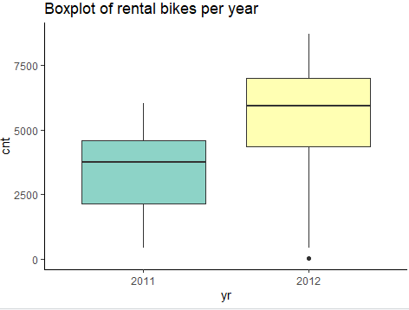
YEAR WITH RESPECT TO COUNT
FROM THIS WE CAN SAY THAT THE COUNT OF BIKES INCREASED IN YEAR 2012

Slide 28
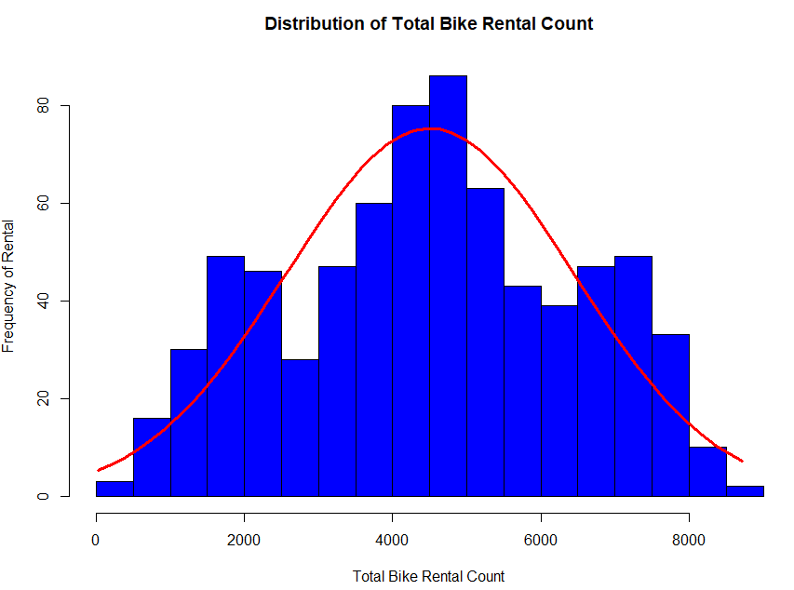
WHEN WE CHECKED THE DISTRIBUTION OF TOTAL BIKE RENTAL COUNT FREQUENCY WE CAN SEE THE FREQUENCY IS NORMAL

Slide 29
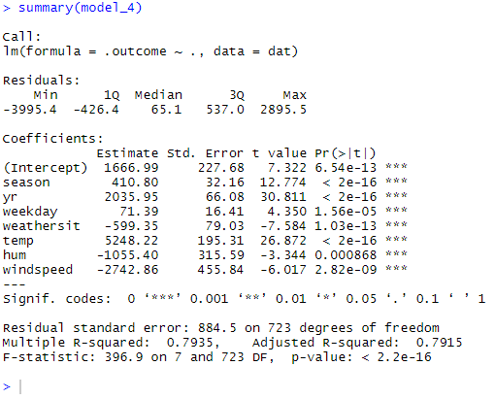
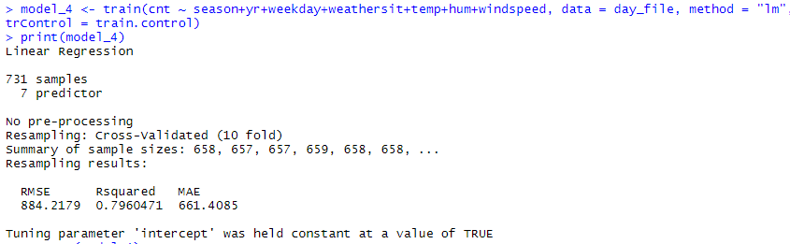
MODEL BUILDING (DAY.CSV) MULTIPLE LINEAR REGRESSION USING (N-FOLD)
WE WILL BE USING N-FOLD CROSS VALIDATION USING BACKWARD ELIMINATION.
USING 95 % CONFIDENCE LEVEL
From the N-fold cross validation we get
Following results :
RMSE – 884.21
Adj-R2 – 0.7915

Slide 30
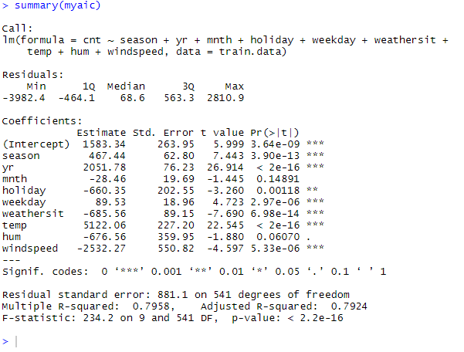
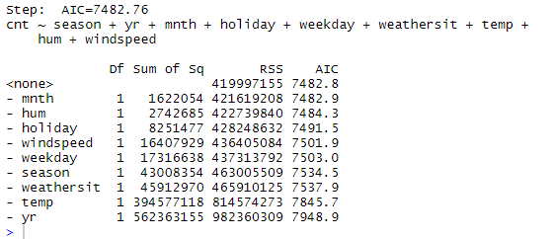
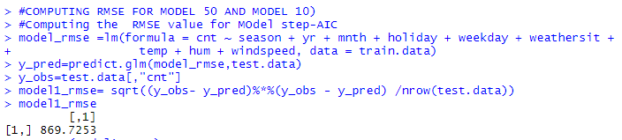
USING AIC / BIC METRICS
NOW WE BUILD A MODEL USING STEP-AIC (FORWARD/BACKWARD AND BOTH)
USING 95 % CONFIDENCE LEVEL
From the STEP-AIC we get
Following results :
RMSE –
869.725
Adj-R2 – 0.7924
AIC Value : 7482.76
Which is
Less than
7514.26
and
7522.55

Slide 31

COMPARISON: ATTRIBUTES WHICH ARE SIGNIFICANTLY IMPACTING AFTER COMPARING BOTH THE MODELS (N-FOLD AND STEP-AIC) ARE :
AFTER COMPARING BOTH THE MODELS WE CAN SAY THAT THE MODEL BUILT USING AIC / BIC HAS THE LARGE ADJ-R2 AND LESS RMSE VALUE, SO THE MODEL USING AIC / BIC FOR THE DAY.CSV IS BEST.
SEASON
YEAR
HOLIDAY
WEEKDAY
WEATHERSIT
TEMPERATURE
HUMIDITY
WINDSPEED
MONTH

Slide 32
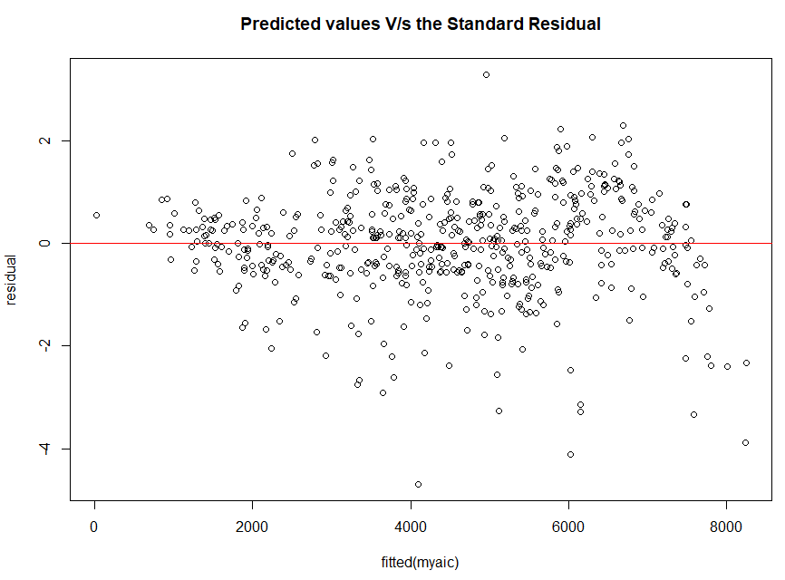
RESIDUAL ANALYSIS OF AIC /BIC: PRED VALUES VS STANDARD RESIDUAL

Slide 33
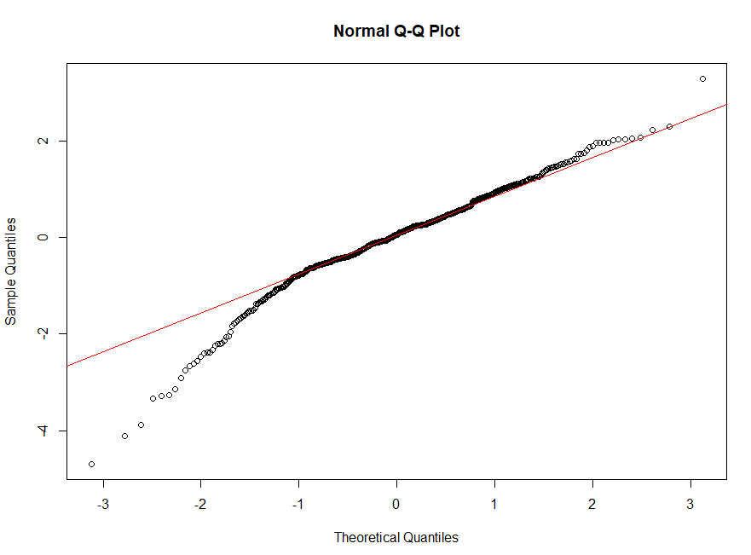
QQ-PLOT

Slide 34
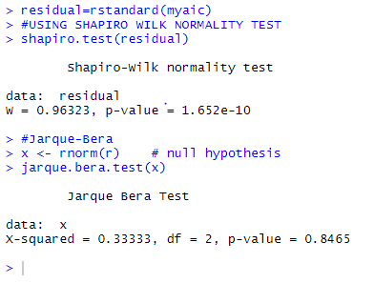
SHAPIRO-WILK AND JARQUE BERA

Slide 35

Fitting Model over different Tuning Parameters Used train() function to set up a grid of tuning parameter for regression model Taking metrics as RMSE methods as “rf”,”knn”,”svmRadical” , “treebag”

Slide 36
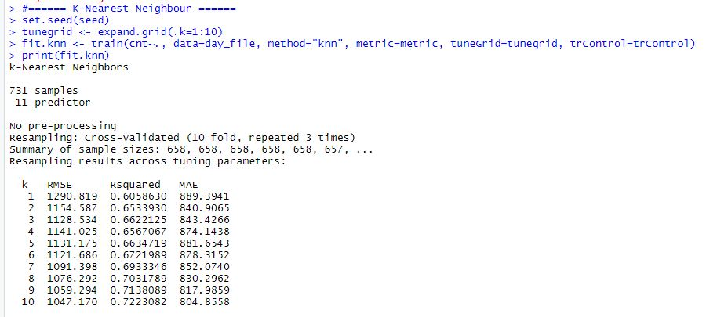
Other Regression Models : k- Nearest Neighbours Algorithm
ADJ R2 = 72.2%
RMSE = 1047.17
The mobility(count of rides) can be analyzed by the features such as:

Slide 37
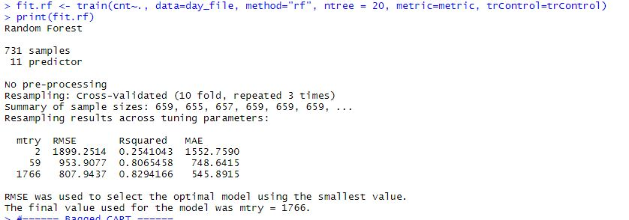
Random Forest Model
ADJ R2 = 82..9%
RMSE = 807.94

Slide 38
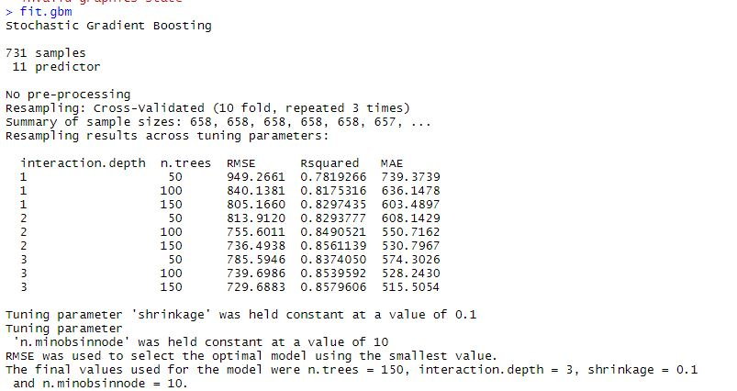
Stochastic Gradient Boosting Model
ADJ R2 = 85.79%
RMSE = 729.6

Slide 39
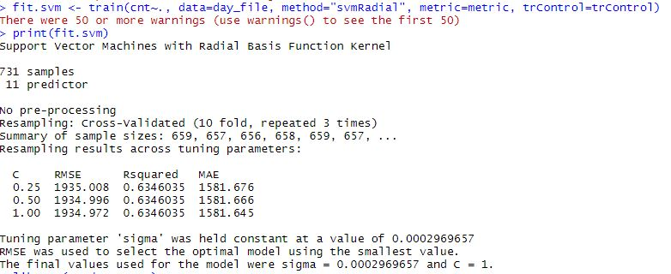
Support Vector Machine Model with SVMRadial method:
ADJ R2 = 63.4%
RMSE = 1934.9

Slide 40
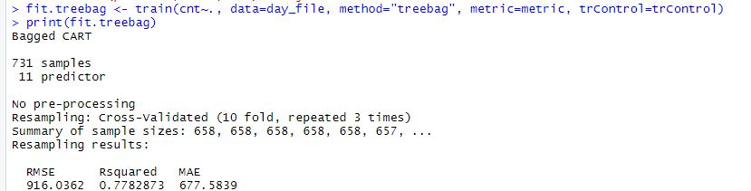
Bagged Cart Model:
ADJ R2 = 77.82%
RMSE = 916.03

Slide 41
INDEX | MODEL | ADJ-R2 | RMSE
1. | MODEL USING AIC-BIC(BOTH) | 79.25% | 869.23
2. | N-FOLD MODEL USING BACKWARD | 79.15% | 884.21
3 | RANDOM FOREST | 82.9% | 807.9
4 | SUPPORT VECTOR MACHINE | 63.4% | 1934.972
5 | K-NN MODEL | 72.2% | 1047.1
6 | STOCHASTIC GRADIENT BOOSTING | 85.99% | 729.688
7 | BAGGED-CART MODEL | 77.8% | 916.8

Slide 42

CONCLUSION
FROM THE WHOLE ANALYSIS OF DATA AND
MODELLING WE GOT TO UNDERSTAND THAT
STOCHASTIC GRADIENT BOOSTING IS THE BEST
AMONG ALL THE MODELS THAT WE HAVE BUILT
BASED ON ADJ-R2 AND RMSE VALUE
FINAL CONCLUSION and predictions:
As a conclusion we can say, that the amount of bike rentals depends mainly on the weather conditions ,season and temperature.
The analysis shows that there is a positive relationship between the amount of bike rentals and weather conditions, season and temperature factors.
So people mainly rent bikes on nice weather conditions or season and good temperature.
This could be important of planning new bike rental stations.

Slide 43


THANK YOU !

